Slide 1
Math Manipulatives
& Montessori
Traveling Montessori’s Path to Abstraction
Presented by:
Jonathan Feagle, Ed.D. & Crystal Alexander
Early Math Symposium
June 23, 2017

Slide 2
What was the first concrete instructional material in history?

Slide 3
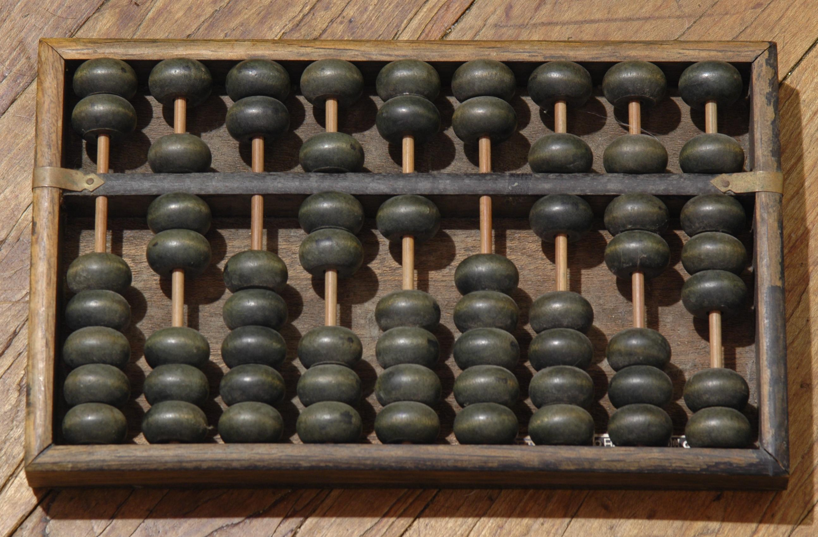
Abacus
China
3,000 B.C.E.
wikipedia.org

Slide 4
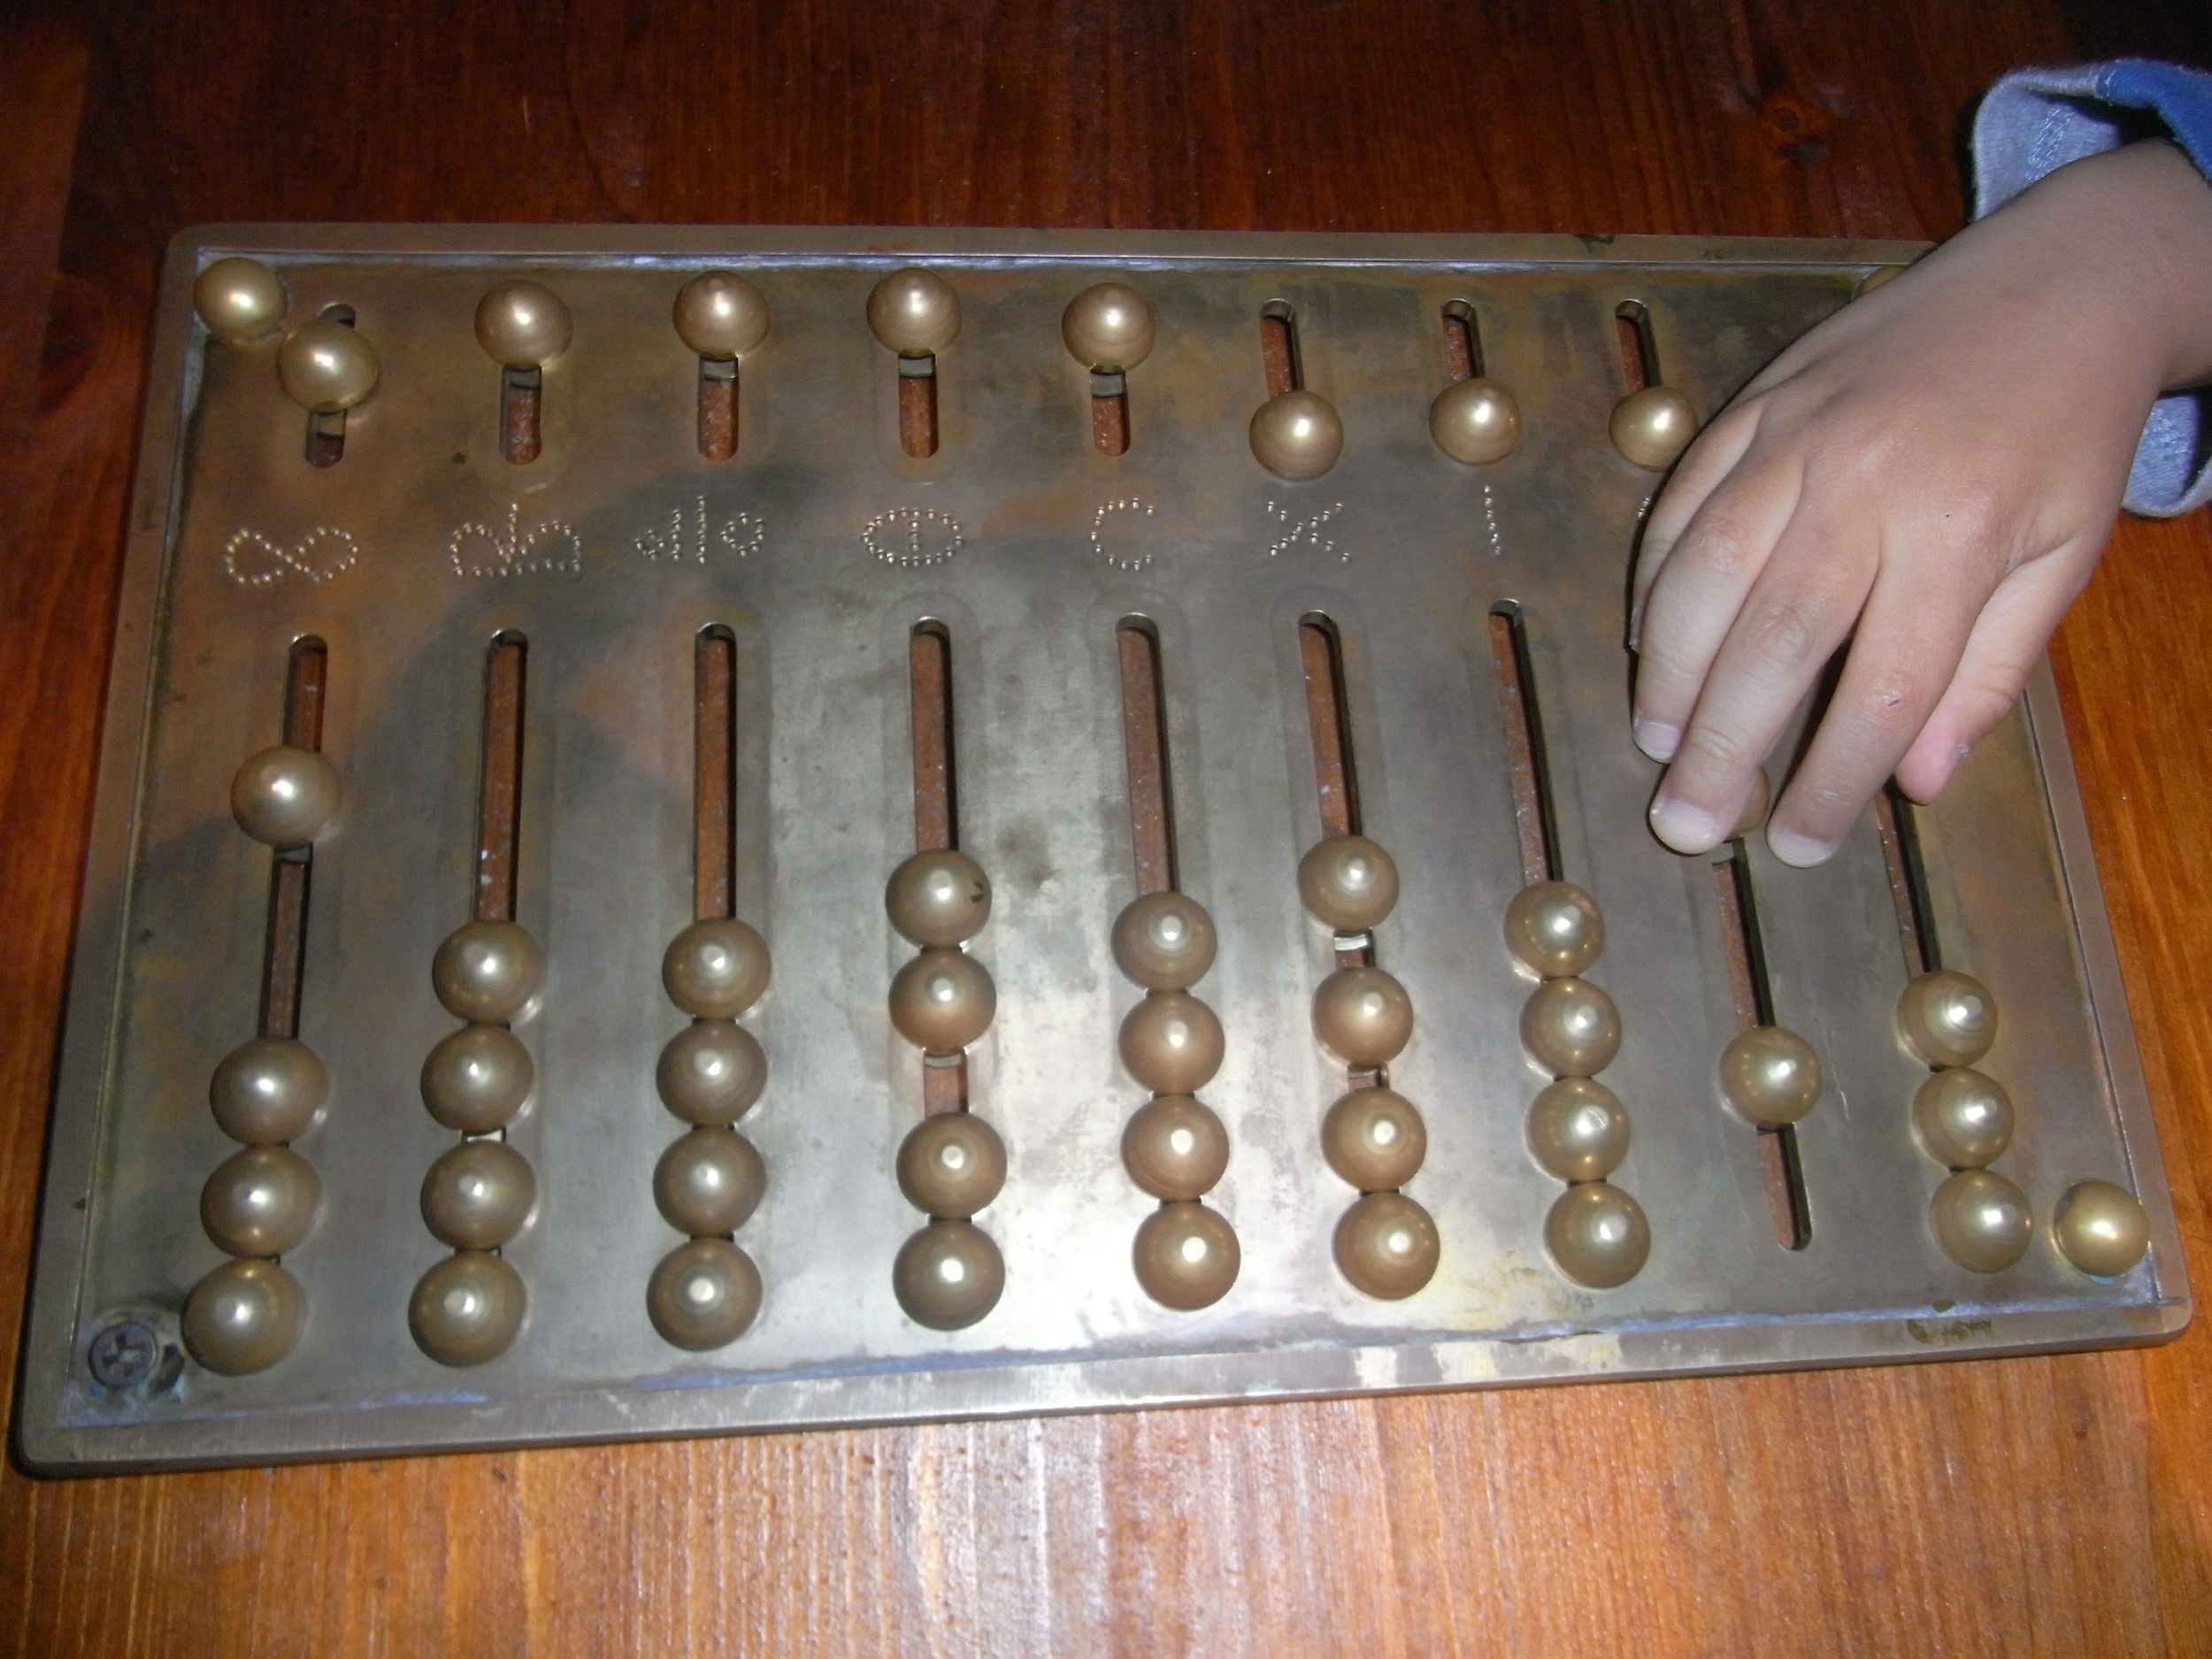
Abacus
Rome
8th - 5th B.C.E.
wikipedia.org
https://culturacientifica.com

Slide 5
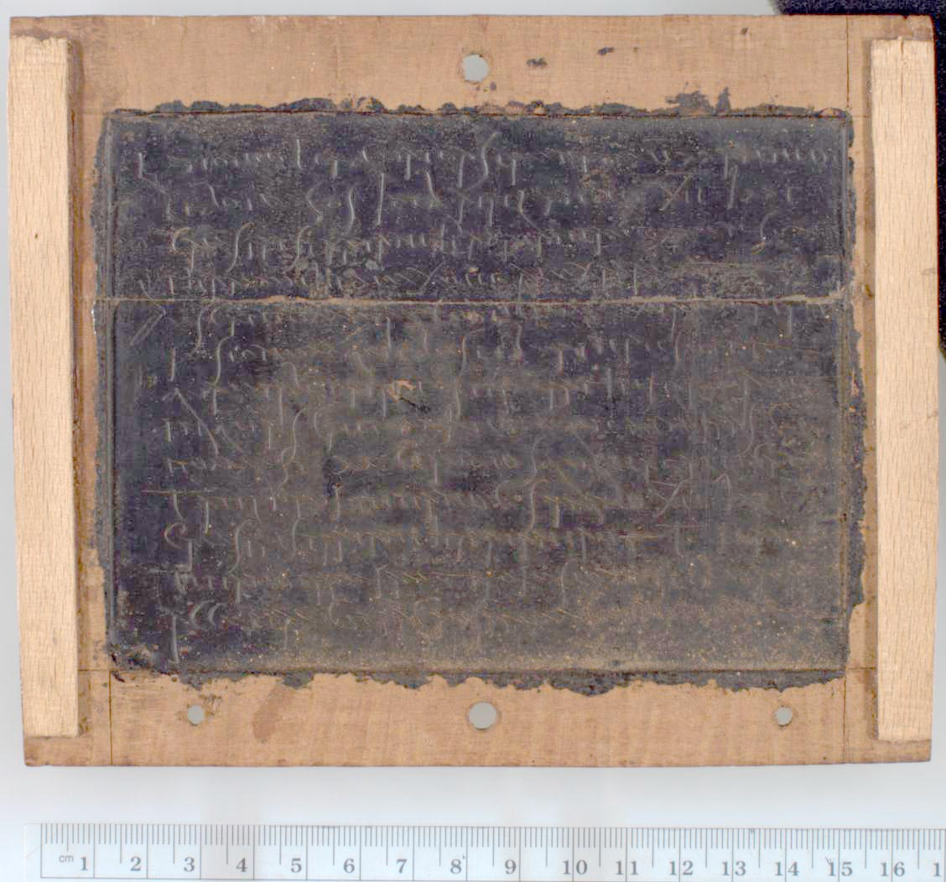
Wax Tablet
Greece
128 A.D.
http://quod.lib.umich.edu

Slide 6
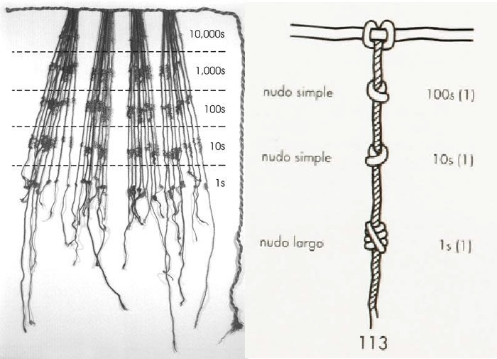
Quipu
Inca Empire
~ 15 Century A.D.
https://culturacientifica.com

Slide 7
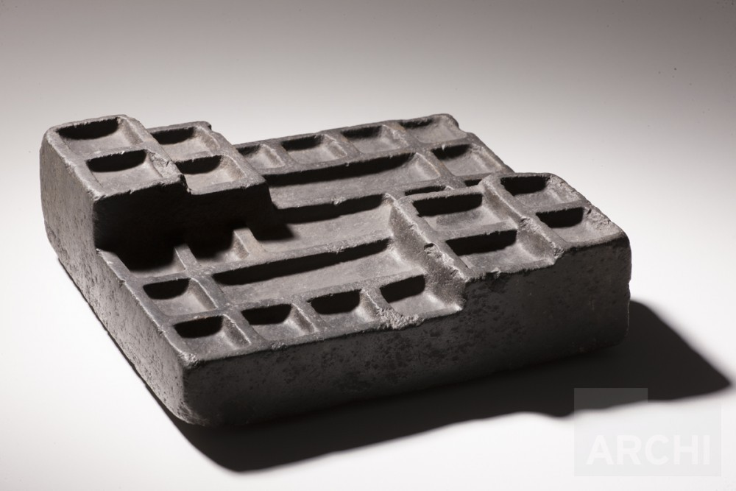
Yupana
Inca Empire
~ 15 Century A.D.
http://archi.pe

Slide 8
Modern Instructional Materials
Designed primarily as instructional materials.
Provide the user with information for further learning.
Do not bear burden of supporting memory as historical materials did.

Slide 9
Modern Instructional Materials
Modern materials raise a different set of questions:
Transference:
How do students transfer knowledge of materials to different and more abstract contexts?
Concrete/Abstract Distinction:
What is the difference between concrete and abstract knowledge?

Slide 10
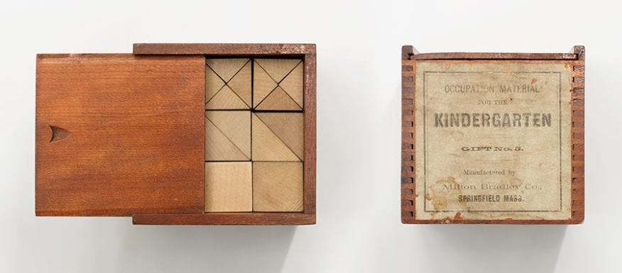
Froebalgaben
(Froebel Gifts)
Friedrich Froebel (Fröbel)
1782 - 1852
http://www.architectmagazine.com

Slide 11
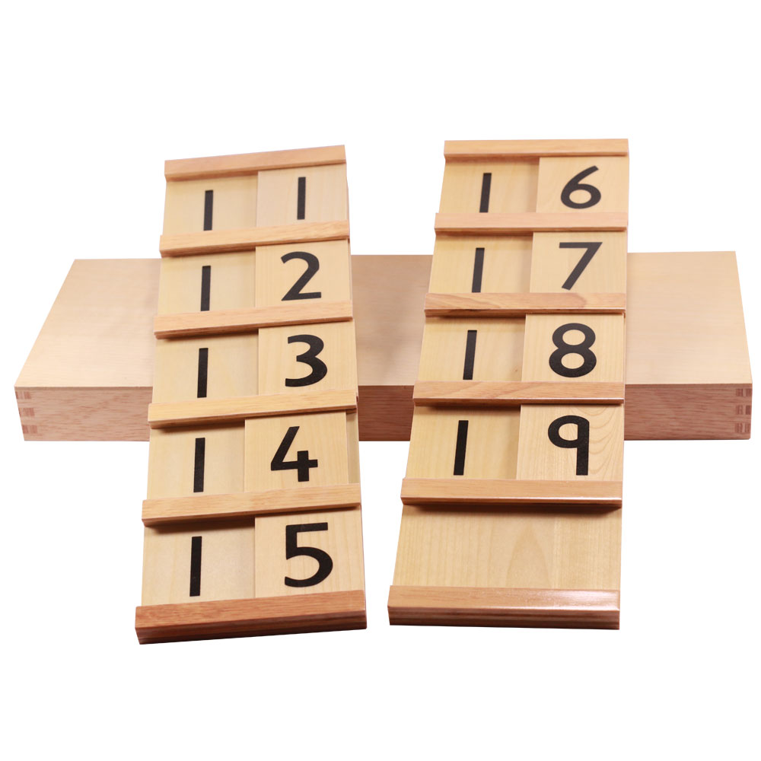
Seguin Board
Édouard Séguin
(1812 – 1880)
http://home.ehanis.com

Slide 12
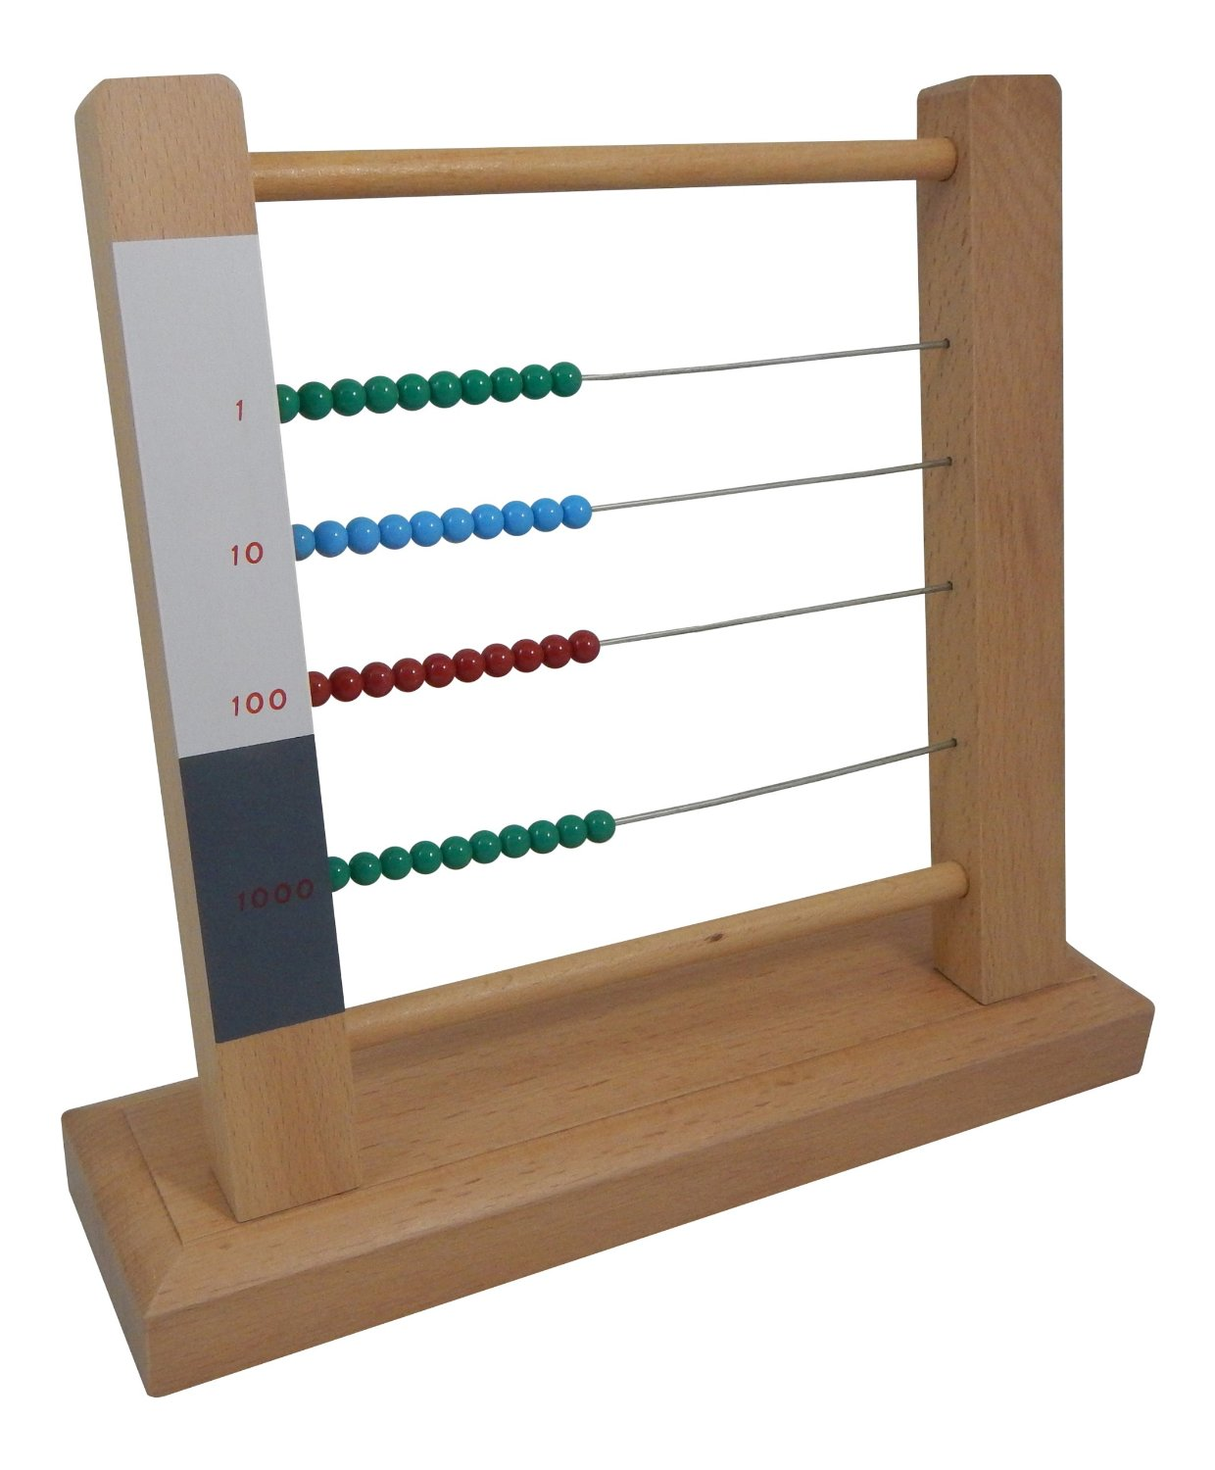
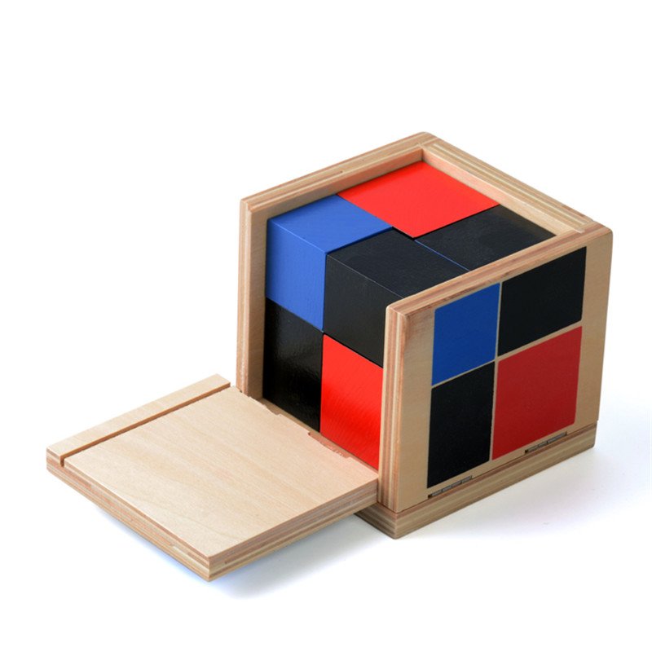
Montessori
1870 - 1952
Small Bead Frame
Algebraic Binomial Cube

Slide 13
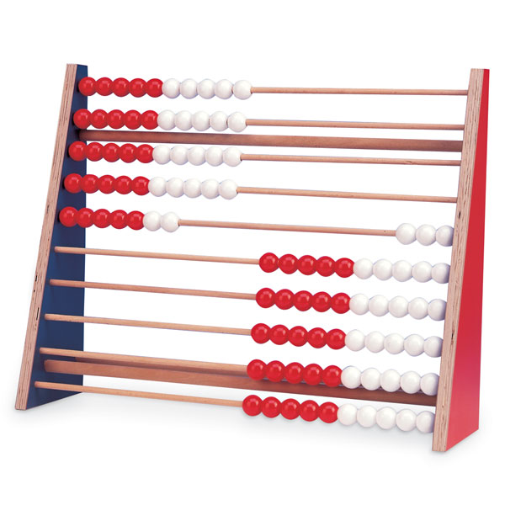
Rekenrek
Netherlands
Early 20th Century A.D.

Slide 14
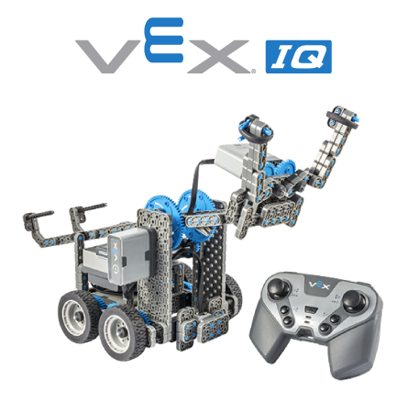
Robots
vexrobotics.com

Slide 15
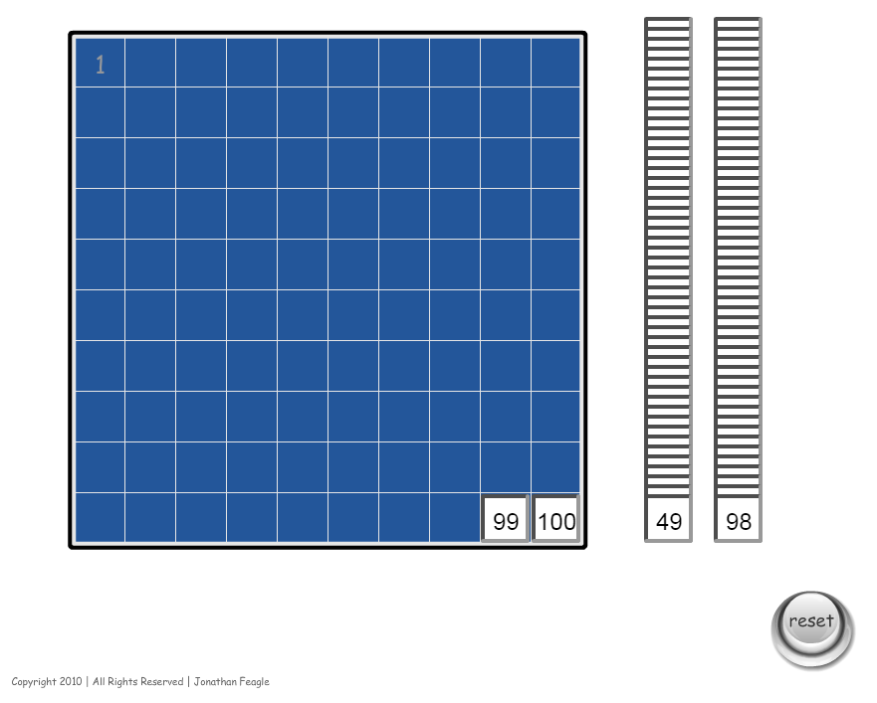
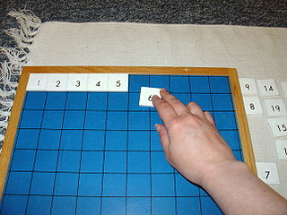
Software
http://www.montessorialbum.com

Slide 16
Concrete Instructional Materials
Concrete / Abstract

Slide 17
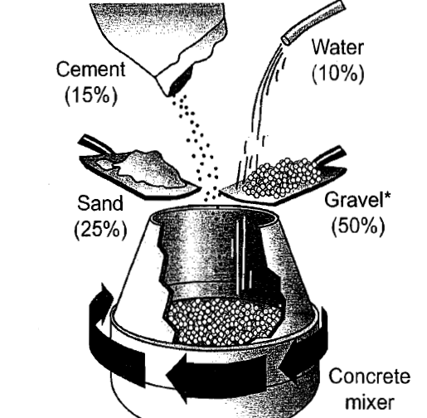
Concrete Instructional Materials

Slide 18
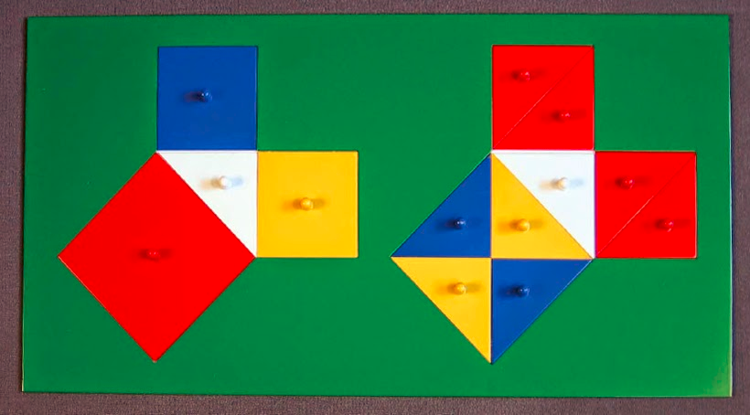
The Big Question
How do we go from left to right?
?
a² + b² = c²

Slide 19
Success not guaranteed
Extraneous perceptual details distract learners from relevant information (Belenky and Schalk, 2014)
Concrete instructional materials draw attention to themselves rather than the underlying content being taught (Uttal et al. 1997)
Constrain transfer of knowledge to novel problems (Goldstone and Sakamoto, 2003)

Slide 20
Theories for why success is not guaranteed
Teacher Perceptions
Dual Representation
Structure of Environment
Link Between Concrete and Abstract Representations

Slide 21
What Does this Mean for Us?
Minimize use of objects highly familiar in a non-learning context

Slide 22
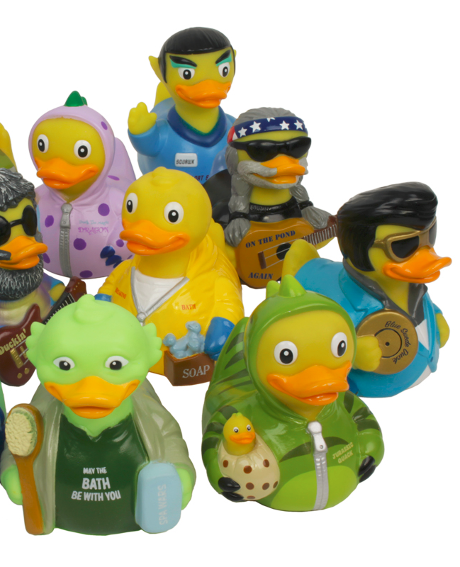
What Does this Mean for Us?
Minimize use of objects that are rich in perceptual detail (at least for younger children)
(there are exceptions.)

Slide 23
The Big Question
Address Transference:
?
a² + b² = c²

Slide 24
Concreteness Fading
Recently articulated in contemporary terms by
Fyfe, McNeil, Son, & Goldstone (2014)
Concreteness Fading in Mathematics and Science Instruction: a Systematic Review
Based on the work of Jerome Bruner 1915- 2016
Theory of Instruction
Concepts and Procedures should be present in 3 stages:
Enactive -> Iconic -> Symbolic

Slide 25
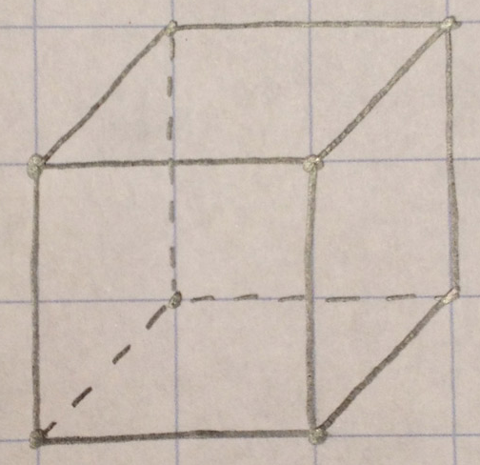
Montessori Geometric Solids
Enactive -> Iconic -> Symbolic
V= a³
A = 6a²

Slide 26
Montessori’s Theory
Experimental Psychology
Materials as Factors of Development:
Determining quantities and qualities of materials
Correspondence between internal needs and external stimuli
Control of Error
Teacher Presentation
Sequence (Staircase) of Materials

Slide 27
Demonstrations

Slide 28
Bibliography
Bouck, E., Satsangi, R., Doughty, T., & Courtney, W. (2014). Virtual and Concrete Manipulatives: A Comparison of Approaches for Solving Mathematics Problems for Students with Autism Spectrum Disorder. Journal of Autism & Developmental Disorders, 44(1), 180-193.
Brown, M. C., McNeil, N. M., & Glenberg, A. M. (2009). Using Concreteness in Education: Real Problems, Potential Solutions. Child Development Perspectives, 3(3), 160-164.
Burns, B. A., & Hamm, E. M. (2011). A Comparison of Concrete and Virtual Manipulative Use in Third- and Fourth-Grade Mathematics. School Science & Mathematics, 111(6), 256-261.
Carbonneau, K. J., Marley, S. C., & Selig, J. P. (2013). A Meta-Analysis of the Efficacy of Teaching Mathematics With Concrete Manipulatives. Journal of Educational Psychology, 105(2), 380-400.
Clements, D. H., & McMillen, S. (1996). RETHINKING "CONCRETE" MANIPULATIVES. Teaching Children Mathematics, 2(5), 270-279.
Flores, M. M. (2010). Using the Concrete--Representational--Abstract Sequence to Teach Subtraction With Regrouping to Students at Risk for Failure. Remedial & Special Education, 31(3), 195-207.
Fyfe, E. R., McNeil, N. M., Son, J. Y., & Goldstone, R. L. (2014). Concreteness Fading in Mathematics and Science Instruction: A Systematic Review. Educational Psychology Review, 26(1), 9-25.
Limin Jao, l. (2013). From sailing ships to subtraction symbols: Multiple representations to support abstraction. International Journal for Mathematics Teaching & Learning, 1-15.

Slide 29
Bibliography
Mancl, D. B., Miller, S. P., & Kennedy, M. (2012). Using the Concrete-Representational-Abstract Sequence with Integrated Strategy Instruction to Teach Subtraction with Regrouping to Students with Learning Disabilities. Learning Disabilities Research & Practice (Wiley-Blackwell), 27(4), 152-166.
Marley, S. C., & Carbonneau, K. J. (2014). Future Directions for Theory and Research with Instructional Manipulatives: Commentary on the Special Issue Papers. Educational Psychology Review, 26(1), 91-100.
Marley, S. C., & Carbonneau, K. J. (2014). Theoretical Perspectives and Empirical Evidence Relevant to Classroom Instruction with Manipulatives. Educational Psychology Review, 26(1), 1-7.
McNeil, N., & Jarvin, L. (2007). When Theories Don't Add Up: Disentangling the Manipulatives Debate. Theory Into Practice, 46(4), 309-316.
Moyer, P. S. (2001). Are We Having Fun Yet? How Teachers Use Manipulatives to Teach Mathematics. Educational Studies in Mathematics, 47(2), 175-197.
Moyer-Packenham, P., Baker, J., Westenskow, A., Anderson, K., Shumway, J., Rodzon, K., & Jordan, K. (2013). A Study Comparing Virtual Manipulatives with Other Instructional Treatments in Third- and Fourth-Grade Classrooms. Journal of Education, 193(2), 25-39.
Sarama, J., & Clements, D. H. (2009). "Concrete" computer manipulatives in mathematics education. Child Development Perspectives, 3(3), 145-150.

